Slide 1
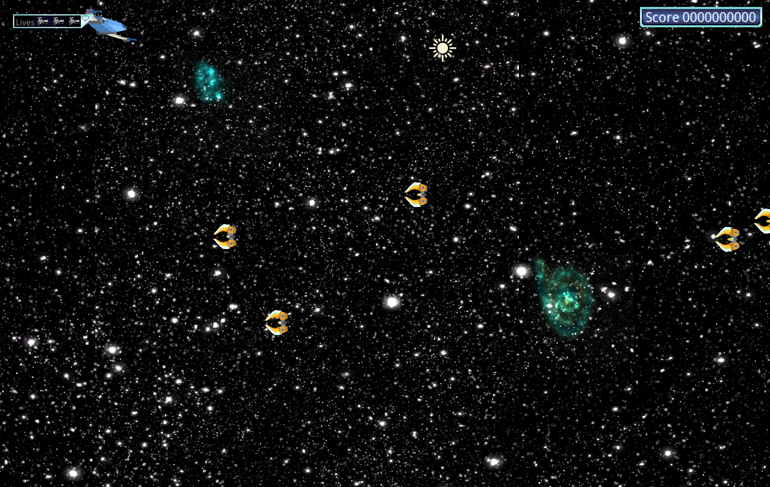
Space Ace Beta
Team: Party of One
Members: Tim Finnegan
Classic SHMUP Action with Physics-Based Gameplay!

Slide 2
Status
Item | Max. Points | Actual Points
Fun to play - peer judged | 15 | 5
Background sound | 5 | 5
Sound FX | 5 | 0
Splash Screen | 2 | 0
Credits – Who did what | 1 | 0
Instructions screen | 2 | 0
Collision detection | 5 | 5
Weapons/damage or scoring system | 15 | 12
New assets | 5 | 5
AI | 15 | 14
Physics | 15 | 15
HUD/UI/GUI | 15 | 15
TOTAL | 100 | 76

Slide 3
